Slide 1
Who Needs Grammar?
You Do! Believe it or not;0)

Slide 2
Our vs. Are

Slide 3
Where vs. we’re (we are)

Slide 4
Fare vs. fair/buy vs. by/there vs. their

Slide 5
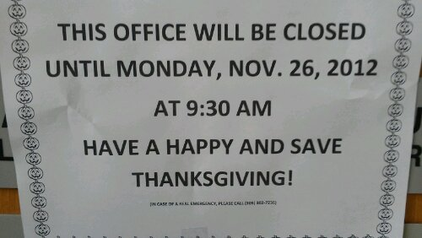
Save vs. safe

Slide 6
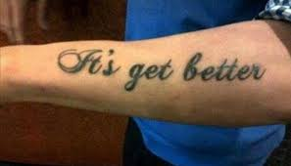
???

Slide 7
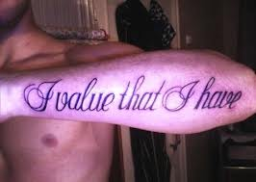
that vs. what

Slide 8
Never don’t = give up!

Slide 9
pee vs. pea

Slide 10
Grammar
Describes how language works
Following the rules of standard English frammar is what allows you to communicate – we follow most of them unconsciously
Grammar tells us a lot about a sentence – even if we don’t know the words:
The rumfrums prattley biggled the pooba

Slide 11
Verbs
Express action
Ex: jump, run, swim
Express an occurrence
Ex: become, happen
Express a state of being
Ex: bee, seem

Slide 12
Helping/Auxiliary
(used interchangeably)
Combine with some verbs to form verb phrases
Can, could, may, might, must, ought, shall, should, will, would
Forms of be: be, am, is, are, was, were, been, being
Forms of have: have, has, had, having
Forms of do: do, does, did
Example of a verb phrase: had been

Slide 13
Sources
Images from Google image search
Grammar: The Little, Brown Handbook 5th edition by Fowler, Aaron and McArthur

