Slide 1
Short Story Terms & Elements of Fiction
English Language Arts

Slide 3
The Short Story
Fictional (imaginary) episodes or events
can usually be read in one sitting
involves fewer characters than the novel
action begins early in the story with little exposition or introduction

Slide 4
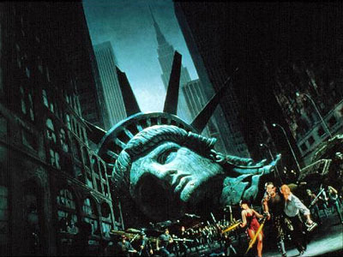
Two Types of Fiction
Escape Fiction: fiction intended chiefly to entertain, providing little or no insight and usually emphasizing plot and action
helps readers escape from the problems of the real world
is meant to give readers pleasure
provides a false or illusionary view of life

Slide 5
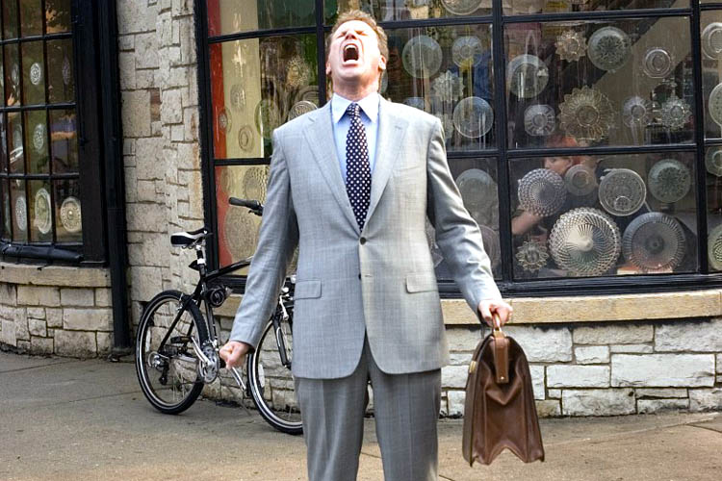
Two Types of Fiction
Interpretive Fiction: fiction intended both to entertain and to offer some insight into humanity or society
takes readers deeper into the real world and its troubles
is meant to give readers pleasure and an increased understanding of life
tries to clear up illusions and depict reality honestly

Slide 6
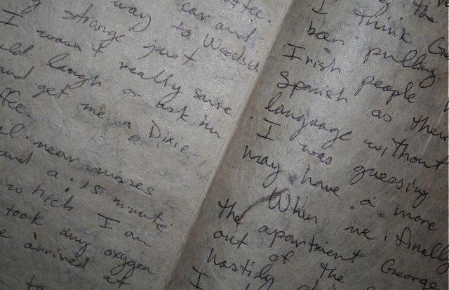
Short Story Theory
Short stories did not appear as distinct units until the 1800s.
It developed first in the United States.

Slide 7
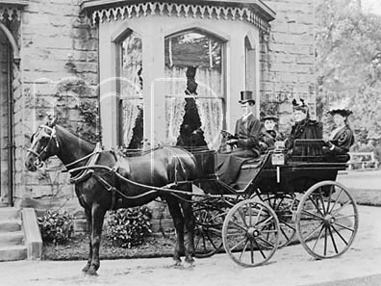
Characteristics of Short Stories - 19th Century
the stories emphasize plot
the story action moves quickly
the plot of the story emphasizes the surprise ending
the stories feature a definite beginning, complication, climax, and resolution
the climax of the story often comes near the end of the tale and it is often unexpected
formal style is used

Slide 8
Characteristics of Short Stories - 20th Century
the emphasis of the story moves away from plot to character, theme, and setting
the story action is slower paced
the stories are not as structured; the stories often begin in the middle or at the end; often the conclusion is left to the reader to determine
the stories emphasize realism in the setting, characterization, and plot
there is much experimentation with style
the formal style found in the 19th century gives way to a colloquial style

Slide 9
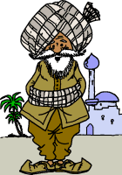
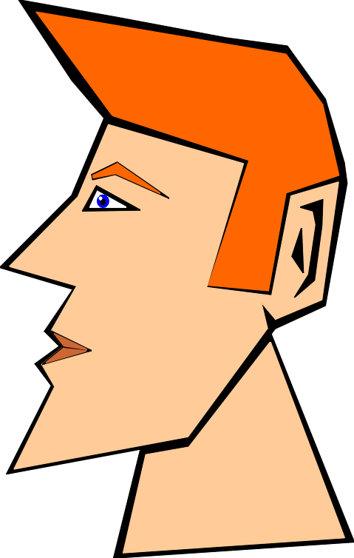
Five Elements of Fiction
Character

Slide 10
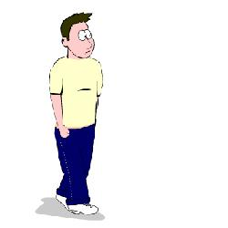
Protagonist
the main character who is struggling against other characters or forces to achieve his/her goal. The protagonist is the one we are most concerned with — does not have to be the good guy)

Slide 11
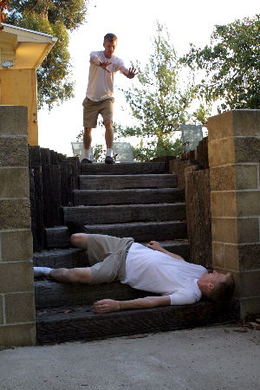
Antagonist
the person or force working against the protagonist (does not have to be the bad guy)

Slide 12
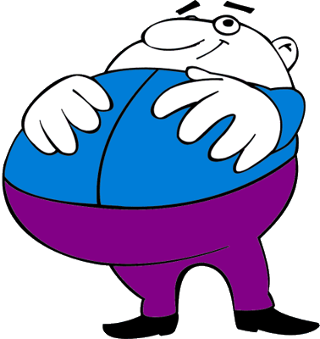
Round Character
A complex, multi-dimensional character. A round character is realistic and life-like because one sees his/her strength and weakness at the same time, just as we do in life.

Slide 13
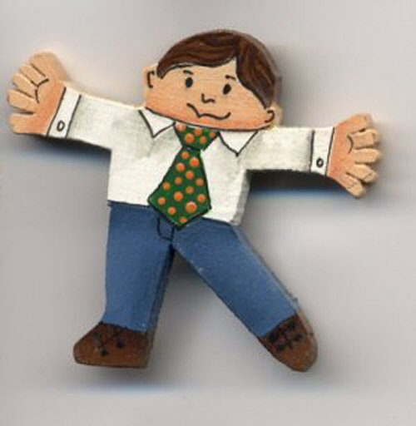
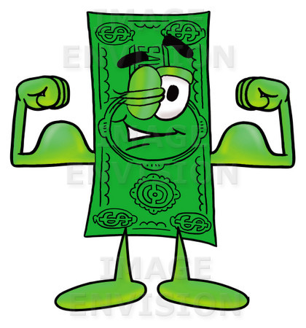
Flat Character
A single-dimensional character lacking the complexity we find in real-life characters. A flat character is generally either good or evil. Minor characters are more likely to be flat characters.

Slide 14
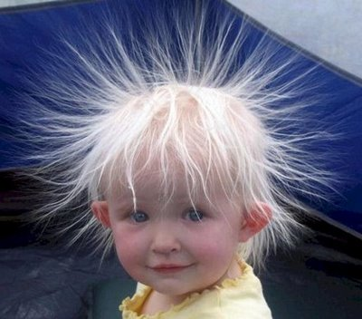
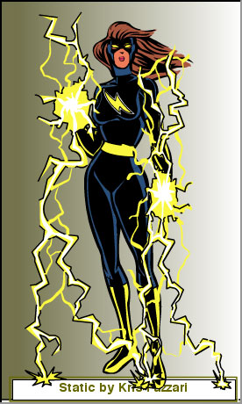
Static Character
one that doesn't change throughout the story

Slide 15
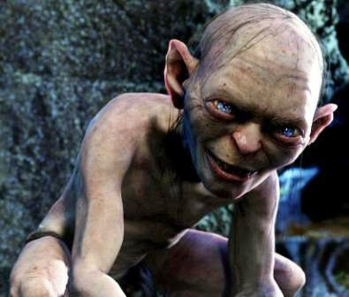
Dynamic or Developing Character
This character undergoes an important change in terms of attitude or personal understanding as a result of the experiences narrated in the short story

Slide 16
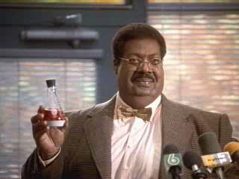
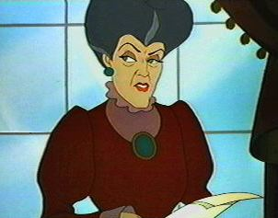
Stock or Stereotype Character
a character that fits the picture we have in our head
Ex: the nutty professor, the wicked stepmother etc.

Slide 17
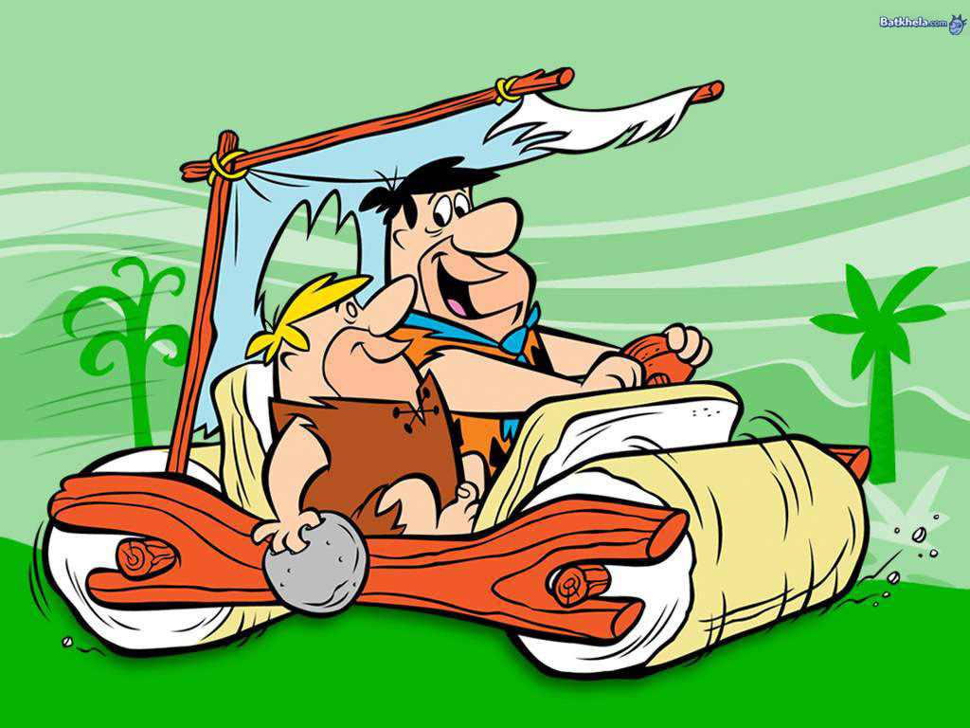
Character Foil
placing two characters side by side so that we can see how different they are
Ex: Fred and Barney from the Flintstones

Slide 18
Characterization
Methods
1.1 Discursive (discourse) Method – the narrator in a straight forward manner feeds the reader information about a person
1.2 Dramatic Method – characters reveal themselves through their actions and words
1.3 Character Appraisal Method - one character’s remarks about another character show personality

Slide 19
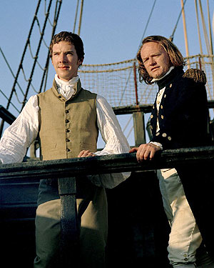
Characterization
Devices of Characterization
2.1 Specific Detail (imagery) – reveals character. The author uses language to develop characters into real people by their actions, thoughts, events, physical appearance, and surroundings.
2.2 Dialogue – what an author has a character say reveals that person’s personality, motivation, education, and in fact, their character.
2.3 Juxtaposition – an author has dissimilar events or people side by side, so the reader is more aware of the differences. Atticus Finch & Robert E. Lee Ewell

Slide 20
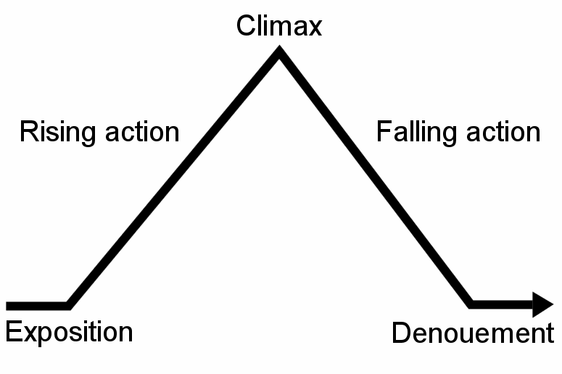
Elements of Fiction
2. Plot

Slide 21
Plot
Definition: “A logical sequence of events”
These events are frequently arranged in chronological order. But authors sometimes use other ways to order events. These might include “flashbacks” and “stream of consciousness.”

Slide 22
Exposition or Antecedent Action
Provides background information about setting, atmosphere, character and theme.

Slide 23
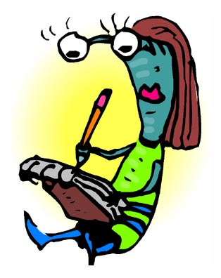
Initial Incident
Introduces a problem which constitutes the first link in a chain of events leading to the climax. The initial incident marks the beginning of the rising action.

Slide 24
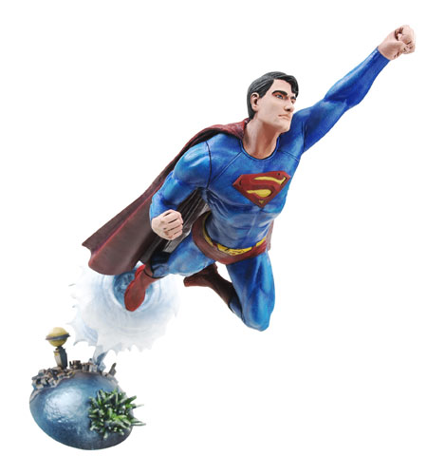
Rising Action
A sequence of events, arranged in escalating order of importance, leading from the initial incident to the climax. This is the part of the short story which creates suspense as the protagonist struggles to achieve his/her goal.

Slide 25
Climax
the highest point of the story that represents the final, decisive confrontation between the protagonist and the individual or forces which oppose him/her.

Slide 26
Falling Action
This short phase of a short story follows immediately after the climax. Its purpose is to show the reader the immediate consequences of the decision reached in the climax.

Slide 27
Dénouement
This short section at the end of a work of fiction resolves the “problem” which the protagonist struggled to overcome. It also ties up any loose ends and reinforces the theme and tone of the selection.

Slide 28
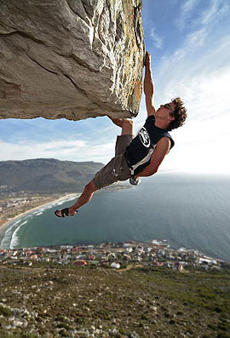
Indeterminate Ending
where we are left without an ending to a story — we don't know how it ends

Slide 29
Elements of Fiction
3. Setting

Slide 30
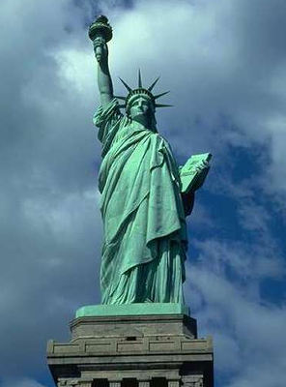
Setting
“Setting” refers to the time and space that the action takes place in.
1. Time Setting: When the action takes place. “Time span” refers to the time between the beginning of the short story or novel and the closing action. This may vary from several hours or days to many years.
2. Physical Setting: the physical locale of the action. Where does the story take place?

Slide 31
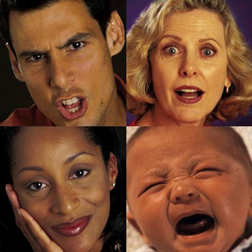
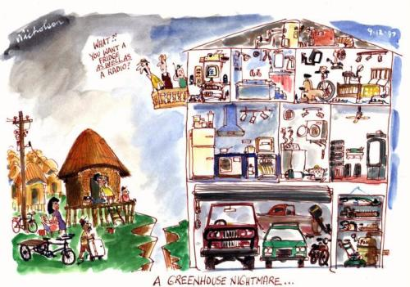
Setting
“Emotional setting” refers to the atmosphere or emotional feelings which are evoked by the setting. It could be ominous or threatening, or romantic and hopeful.
Social setting – includes a person’s social status, what he/she does for a living, economic well-being, gender etc. Everything that makes up where a person fits into society.

Slide 32
Elements of Fiction
Theme

Slide 33
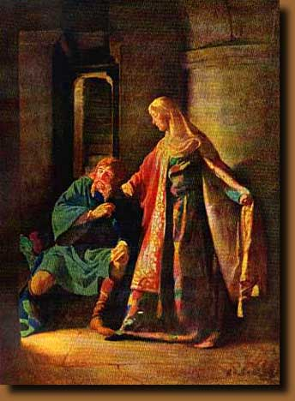
Theme
The theme is a statement of the general idea of a short story. It is a “general” statement of a universal idea, rather than a statement about a particular character or event.
The theme of Macbeth, for instance, is not that Macbeth is excessively ambitious. That statement is too narrow, too specific.
A better statement would be as follows:
“The theme of William Shakespeare’s Macbeth is that uncontrolled ambition can destroy an individual’s most admirable human qualities.”

Slide 34
Theme includes...
the author's view of life. The reader knows what the author thinks about people or life in general after they have read the story

Slide 35
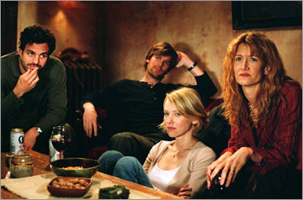
Theme – Implied
the reader figures it out from the story

Slide 36
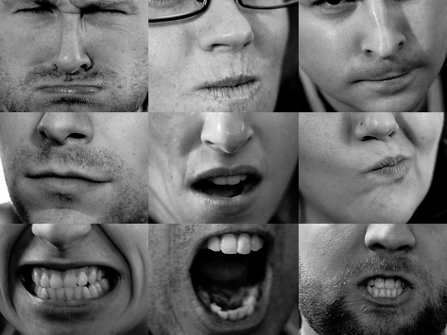
Theme – or it is expressed
the author comes right out and states his/her view of life. This is different from main idea

Slide 37
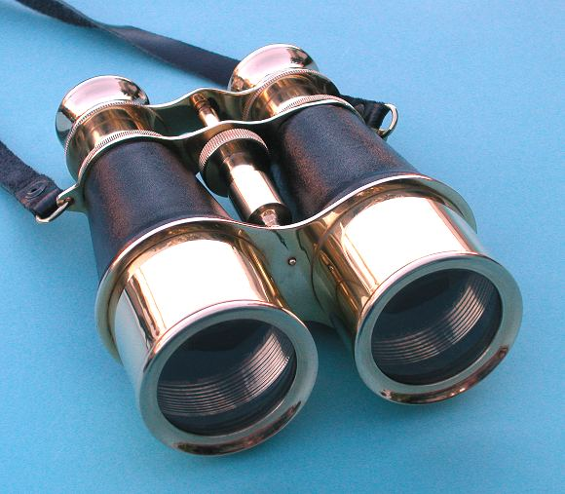
Elements of Fiction
5. Point of View

Slide 38
Point of View
This refers to the perspective from which the events of the short story are narrated. You know from your own personal experience that an account of an event can vary greatly, depending on the point of view of the person describing it.
There are many variations of point of view, and sometimes writers will use several points of view in one work.

Slide 39
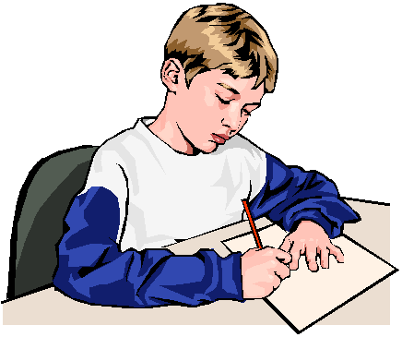
First Person
told from the "I" perspective, the story is told as though one of the characters was speaking directly
Ex: "I went to bed early that night, and when I awoke, there was a thick fog."

Slide 40
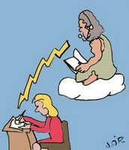
Third Person Limited Omniscient
told from a narrator’s point of view ( as though someone outside of the story was telling it )
We read the thoughts and feelings of one character only
Ex: "When Billy got out of bed, he tripped on the cat.”

Slide 41
Third Person Omniscient
"all knowing,” a narrator tells the story and we get to know what everyone is thinking and feeling
This narrator has a god-like vision of events & characters.

Slide 42
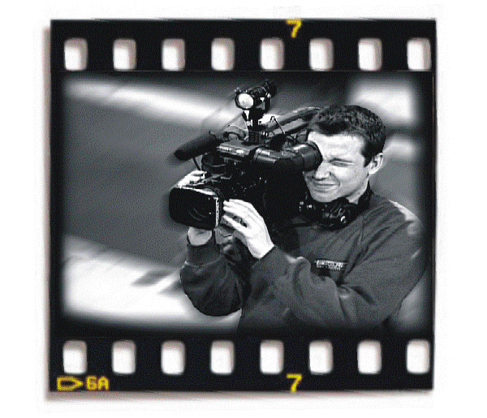
Third Person “Objective” or “Dramatic”
The “objective” or “dramatic” point of view means that the narrator functions as a television cameraman. The objective narrator tells the reader what he sees or hears but does not interpret the motives or feelings of the characters.

Slide 43
Irony – the opposite of what is expected
Verbal Irony – occurs when what a character says contrasts what the character actually means.
Dramatic Irony – occurs when what a character says or believes contrasts with what the reader or other characters know to be true. The reader knows more about the truth than the character does.
Situational Irony – (or irony of situation) occurs when what finally takes place is different from what was expected or seemed appropriate.

Slide 44
All images obtained from “google images” via public domain

