Slide 1
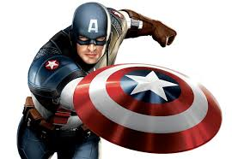
Notes:
Captain America – The Hero – Superhero, expert mastery in a way that improves the world, be strong and competent as possible

Slide 2
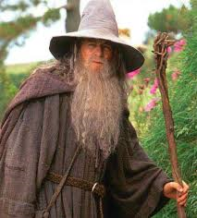
Notes:
Gandalf: The Magician – I can make thins happen – develop a vision and live by it – a visionary, catalyst, charismatic leader

Slide 3
Notes:
Young person from the Provinces – hero is taken away as an infant and raised by strangers. He later returns home as a stranger and able to recognize new problems and new solutions

Slide 4
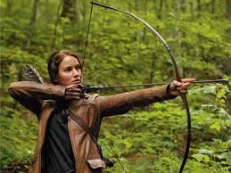
Notes:
The initiates – young hero, prior to quest, must endure some training and ritual. They are usually innocent at this stage.

Slide 5
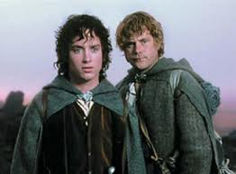
Notes:
Hero – young person from the provinces & Loyal retainer: noble sidekicks to the hero. Their duty is to protect the hero. Often the retainer reflect the hero’s nobility

Slide 6
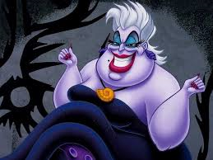
Notes:
The Devil figure – represents evil incarnate – may offer worldly goods, fame, or knowledge to the protagonist in exchange for possession of the soul or integrity. This figure’s main aim is to oppose the hero in his quest.

Slide 7
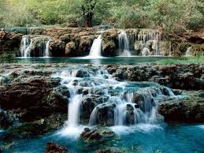
Notes:
Water: water necessary to life and growth – birth or tebirth, baptism, appearance of reain can suggest a character’s spiritual rebirth

Slide 8
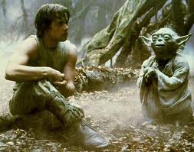
Notes:
Mentor: teacher to initiates. Role model/father figure. Teach by example the skills necessary to survive the journey and quest

Slide 9
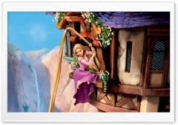
Notes:
Damsel in distress – a vulnerable woman who must be rescued by the hero. She also may be used as a trap, by an evil figure, to ensnare the hero

Slide 10
Archetype
This word derived from the Greek word archein which means original or old; and typos, which means “pattern, model or type.” Therefore archetype means an “orginal pattern” of which all other similar persons, objects, or concepts are derived, copied, modeled or emulated.

Slide 11
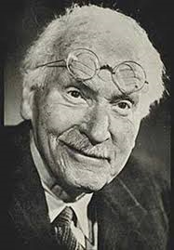
Carl Gustav Jung (1875 – 1961)
Proposed and developed the concept of archetypes
- he believed that universal, mythic characters- archetypes – reside with in the collective unconscious of people all over the world
-Archetypes represent fundamental human motif of our experience as we evolved; consequentially, they evoke deep emotions.
Notes:
Motif: reoccurring subject or theme

Slide 12
Resources
www.soulcraft.co/essays/the_12common_archetypes.html
Common Archetypes and Symbols in Literature – AP Lang Gonzo

