Slide 1
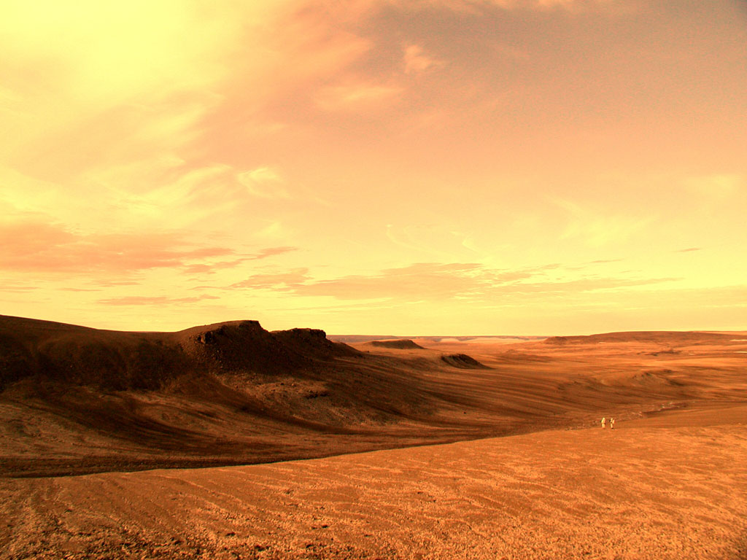
Where is this, what is going on?

Slide 2
Where in the world...
The Arctic
KWL
Notes:
Hand out KWL charts for the students to fill in – individually – about the arctic. On the reverse of this sheet have a title “reasons to live in the arctic.” Both of these sheets will be added to through out the unit.

Slide 3
Documentation about the Life of the Intuits Eskimos Part I
http://www.youtube.com/watch?v=_U6X6f7qCnQ

Slide 4
About The Life...part II
http://www.youtube.com/watch?v=3pKjLHipINo

Slide 5
About The Life...Part III
http://www.youtube.com/watch?v=2rkKjnpe3nM

Slide 6
Latitude & Longitude
https://www.youtube.com/watch?v=-0c1idtn3e8
I can appreciate the geographic diversity of Canada
I can discover the factors that determine climate in Canada
I can use latitude and longitude to determine absolute location of a given place.

Slide 7
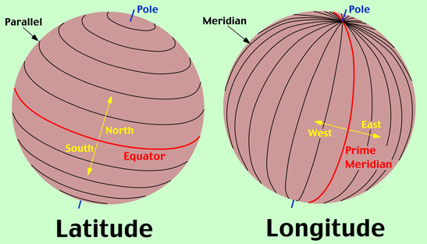
Latitude & Longitude
EQUATOR: marks center of a map/globe
any location north of the equator is indicated by a North or “N”, any location south of the equator is indicated by a South or “S”
PRIME MERIDIAN: determines start point
Any location to the left is West or “W,” and any location to the right is East or “E.”
Notes:
The equator is an imaginary line,

Slide 8
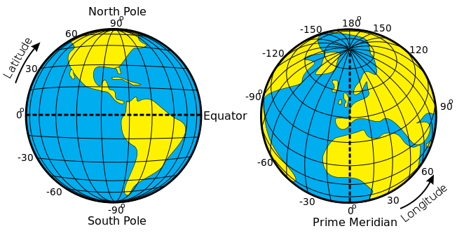
Latitude & Longitude
Latitude is always given before Longitude: 49 N 100 E
Latitude lines are parallel but longitude lines are not
Latitude effects climate, longitude does not

Slide 9
Latitude & Longitude
Practice:

